Slide 1


Slide 3

I’VE GOT THE JOY JOY JOY
I’ve got the joy, joy, joy, joy
Down in my heart.
Down in my heart,
Down in my heart.

Slide 4
I’VE GOT THE JOY JOY JOY
I’ve got the joy, joy, joy, joy
Down in my heart.
Down in my heart,
To stay

Slide 5
I’VE GOT THE JOY JOY JOY
I’ve got the joy, joy, joy, joy
Down in my heart.
Down in my heart,
Down in my heart.

Slide 6
I’VE GOT THE JOY JOY JOY
I’ve got the joy, joy, joy, joy
Down in my heart.
Down in my heart,
To stay

Slide 7
I’VE GOT THE JOY JOY JOY

Slide 8
I’VE GOT THE JOY JOY JOY
I’ve got the love of Jesus
Love of Jesus
Down in my heart
Down in my heart,
down in my heart

Slide 9
I’VE GOT THE JOY JOY JOY
I’ve got the love of Jesus,
Love of Jesus
Down in my heart.
Down in my heart to stay.

Slide 10
I’VE GOT THE JOY JOY JOY
I’ve got the peace
That passes understanding
Down in my heart.
Down in my heart, down in
My heart

Slide 11
I’VE GOT THE JOY JOY JOY
I’ve got the peace
That passes understanding
Down in my heart.
Down in my heart to stay

Slide 12
I’VE GOT THE JOY JOY JOY
I’ve got the joy, joy, joy, joy
Down in my heart.
Down in my heart,
Down in my heart.

Slide 13
I’VE GOT THE JOY JOY JOY
I’ve got the joy, joy, joy, joy
Down in my heart.
Down in my heart,
To stay

Slide 14
I’VE GOT THE JOY JOY JOY
I’ve got the joy, joy, joy, joy
Down in my heart.
Down in my heart,
Down in my heart.

Slide 15
I’VE GOT THE JOY JOY JOY
I’ve got the joy, joy, joy, joy
Down in my heart.
Down in my heart,
To stay

Slide 16
I’VE GOT THE JOY JOY JOY
Down in my heart
To stay.
Down in my heart
To stay.

Slide 18


Slide 20


Slide 22
CALL TO WORSHIP
Leader
Praise the Lord, you who worship the Lord; stand in awe of God and give glory to the Lord.

Slide 23
Congregation
For the Lord does not despise the poor and needy, but when they cry out, God answers them.

Slide 24
CALL TO WORSHIP
Leader
The hungry shall eat and be satisfied, and those who love the Lord shall offer praise

Slide 25
CALL TO WORSHIP
Congregation
All the ends of the earth shall worship God, for the Lord rules over every nation.

Slide 27
THIS LITTLE LIGHT OF MINE
This little light of mine,
I'm gonna to let it shine.
(3X)
Let it shine, let it shine,
let it shine.

Slide 28
THIS LITTLE LIGHT OF MINE
Hide it under a bushel, no!
I’m gonna let it shine.
(3x)
Let it shine, let it shine,
let it shine

Slide 29
THIS LITTLE LIGHT OF MINE
Don’t let Satan blow it out.
I’m gonna let it shine.
(3x)
Let it shine, let it shine,
let it shine.

Slide 30
THIS LITTLE LIGHT OF MINE
Let it shine till Jesus comes.
I’m gonna let it shine.
(3x)
Let it shine, let it shine,
let it shine.

Slide 31
THIS LITTLE LIGHT OF MINE
This little light of mine,
I’m gonna let it shine.
(3x)
Let it shine, let it shine,
let it shine.

Slide 33
HOLY SPIRIT
There’s nothing worth more,
That will ever come close
No thing can compare,
You’re our living hope
Your presence Lord

Slide 34
HOLY SPIRIT
I’ve tasted and seen
Of the sweetest of Love
Where my heart becomes free
And my shame is undone
Your presence Lord

Slide 35
HOLY SPIRIT
Holy spirit
You are welcome here
Come flood this place
And fill the atmosphere

Slide 36
HOLY SPIRIT
Your glory God
Is what our hearts long for
To be overcome
By your presence Lord

Slide 37
HOLY SPIRIT
There’s nothing worth more
That will ever come close
No thing can compare,
You’re our living hope
Your presence LORD

Slide 38
HOLY SPIRIT
I’ve tasted and seen
Of the sweetest of love
Where my heart becomes free
And my shame is undone
Your presence LORD

Slide 39
HOLY SPIRIT
Holy spirit
You are welcome here
Come flood this place
And fill the atmosphere

Slide 40
HOLY SPIRIT
Your glory God
Is what our hearts long for
To be overcome
By your presence Lord
Your presence Lord

Slide 41
HOLY SPIRIT
Let us become
More aware of your presence
Let us experience
The glory of Your goodness

Slide 42
HOLY SPIRIT
Let us become
More aware of your presence
Let us experience
The glory of Your goodness

Slide 43
HOLY SPIRIT
Holy spirit
You are welcome here
Come flood this place
And fill the atmosphere

Slide 44
HOLY SPIRIT
Your glory God
Is what our hearts long for
To be overcome
By your presence Lord
Your presence Lord

Slide 46
I AM NO LONGER A SLAVE TO FEAR
Ooh, ooh
You unravel me
With a melody

Slide 47
I AM NO LONGER A SLAVE TO FEAR
You surround me with a song
Of deliverance
From my enemies
‘Til all my fears are gone

Slide 48
I AM NO LONGER A SLAVE TO FEAR
I’m no longer a slave to fear
I am a child of God
I’m no longer a slave to fear
I am a child of God

Slide 49
I AM NO LONGER A SLAVE TO FEAR
From my mother’s womb
You have chosen me
Love has called my name

Slide 50
I AM NO LONGER A SLAVE TO FEAR
I’ve been born again
Into Your family
Your blood flows
Through my veins

Slide 51
I AM NO LONGER A SLAVE TO FEAR
I’m no longer a slave to fear
I am a child of God
I’m no longer a slave to fear
I am a child of God
x2

Slide 52
I AM NO LONGER A SLAVE TO FEAR
I am surrounded
By the arms of the Father
I am surrounded
By songs of deliverance

Slide 53
I AM NO LONGER A SLAVE TO FEAR
We’ve been liberated
From our bondage
We’re the sons and the daughters
Let us sing our freedom

Slide 54
I AM NO LONGER A SLAVE TO FEAR
Ooh, ooh
Ooh, ooh
Ooh, ooh
Ooh, ooh

Slide 55
I AM NO LONGER A SLAVE TO FEAR
You split the sea
So I could walk right through it
My fears are drowned
In perfect love

Slide 56
I AM NO LONGER A SLAVE TO FEAR
You rescued me
So I could stand and say
I am a child of God

Slide 57
I AM NO LONGER A SLAVE TO FEAR
You split the sea
So I could walk right through it
My fears are drowned
In perfect love

Slide 58
I AM NO LONGER A SLAVE TO FEAR
You rescued me
So I could stand and say
I am a child of God

Slide 59
I AM NO LONGER A SLAVE TO FEAR
I am a child of God
Yes, I am a child of God.

Slide 61

JOHN 3:1-17
“THE SECRET DISCIPLE”
PASTOR DAN ALBERTSON

Slide 62
Now there was a Pharisee named Nicodemus, a leader of the Jews. He came to Jesus by night and said to him, “Rabbi, we know that you are a teacher who has come from God; for no one can do these signs that you do apart from the presence of God.”
JOHN 3:1-2 (NRVCA)

Slide 63
Jesus answered him, “Very truly, I tell you, no one can see the kingdom of God without being born from above.” Nicodemus said to him, “How can anyone be born after having grown old? Can one enter a second time into the mother’s womb and be born?”
JOHN 3:3-4 (NRVCA)

Slide 64
Jesus answered, “Very truly, I tell you, no one can enter the kingdom of God without being born of water and Spirit. What is born of the flesh is flesh, and what is born of the Spirit is spirit. Do not be astonished that I said to you, ‘You must be born from above.
JOHN 3:5-7 (NRVCA)

Slide 65
‘The wind blows where it chooses, and you hear the sound of it, but you do not know where it comes from or where it goes. So it is with everyone who is born of the Spirit.” Nicodemus said to him, “How can these things be?”
Jesus answered him,
JOHN 3:8-10 (NRVCA)

Slide 66
“Are you a teacher of Israel, and yet you do not understand these things?
“Very truly, I tell you, we speak of what we know and testify to what we have seen; yet you do not receive our testimony. If I have told you about earthly things and you do not believe
JOHN 3:10-12 (NRVCA)

Slide 67
how can you believe if I tell you about heavenly things? No one has ascended into heaven except the one who descended from heaven, the Son of Man. And just as Moses lifted up the serpent in the wilderness, so must the Son of Man be lifted up,
JOHN 3:12-14 (NRVCA)

Slide 68
that whoever believes in him may have eternal life. “For God so loved the world that he gave his only Son, so that everyone who believes in him may not perish but may have eternal life. “Indeed, God did not send
JOHN 3: 15-17(NRVCA)

Slide 69
the Son into the world to condemn the world, but in order that the world might be saved through him.
JOHN 3:17 (NRVCA)

Slide 70
PASTOR:
This is the Gospel of our Lord
ALL :
Praise to you, O Christ

Slide 72
O FOR A THOUSAND TONGUES TO SING #466
O for a thousand tongues to sing
My dear Redeemer’s praise,
The glories of my god and King
The triumphs of God’s grace!

Slide 73
O FOR A THOUSAND TONGUES TO SING #466
Jesus the name that
charms our fears,
That bids our sorrows cease;
‘Tis music in the sinner’s ears,
‘Tis life, and health, and peace

Slide 74
O FOR A THOUSAND TONGUES TO SING #466
Christ breaks the power
of reigning sin,
And sets the prisoner free;

Slide 75
O FOR A THOUSAND TONGUES TO SING #466
Christ’s blood can make
the sinful clean,
Christ’s blood availed for me

Slide 76
O FOR A THOUSAND TONGUES TO SING #466
My gracious Master and my God,
Assist me to proclaim,
To spread through all
the earth abroad
The honors of Thy name

Slide 77

PLEASE GIVE ONLINE AT
www.sierravistayuma.com
OR MAIL YOUR TITHES AND
OFFERINGS TO THE CHURCH.
150 W. 28th St.
Yuma, AZ 85364

Slide 79

DOXOLOGY
Praise God,
From whom all blessings flow;
Praise Him,
all creatures here below
Praise Him
above, ye heavenly host.
Praise Father,
son and Holy Ghost. Amen

Slide 81
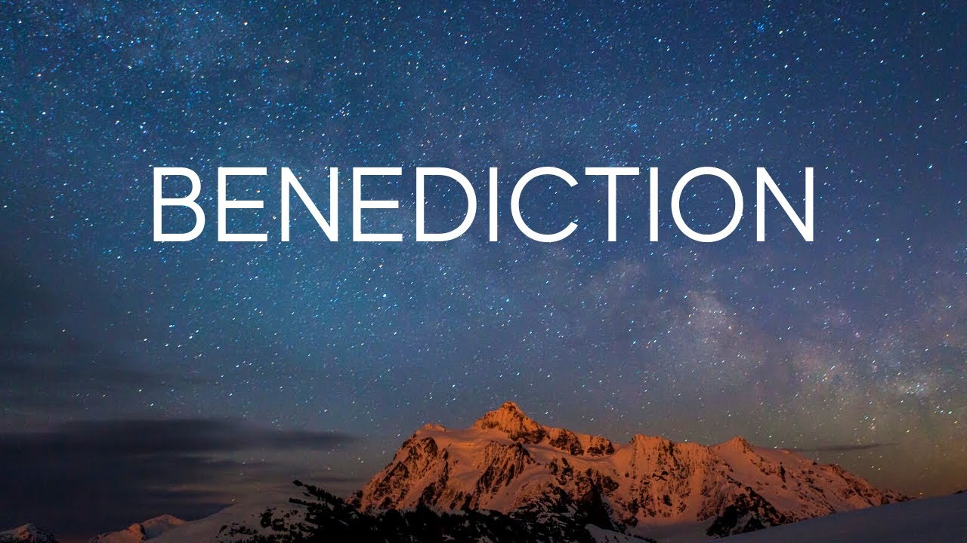

Slide 82


Slide 84
CROWN HIM WITH MANY CROWNS #151
Crown Him with many crowns,
The Lamb upon His throne;
Hark, how the heavenly
Anthem drowns
All music but its own!

Slide 85
CROWN HIM WITH MANY CROWNS #151
Awake, my soul, and sing
Of Him who died for thee,
And hail Him as thy
Matchless King
Through all eternity.

Slide 86
CROWN HIM WITH MANY CROWNS #151
Crown Him the Lord of love;
Behold His hands and side,
Rich wounds, yet visible above,
In beauty glorified:

Slide 87
CROWN HIM WITH MANY CROWNS #151
No angel in the sky
Can fully bear that sight,
But downward bends
His burning eye
At mysteries so bright

Slide 88
CROWN HIM WITH MANY CROWNS #151
Crown Him the Lord of peace;
Whose power a scepter sways
From people to pole,
That wars may cease,

Slide 89
CROWN HIM WITH MANY CROWNS #151
Absorbed in prayer and praise:
His reign shall know no end;
And round His pierced feet
Fair flower of paradise extend
Their fragrance ever sweet.

Slide 90
CROWN HIM WITH MANY CROWNS #151
Crown Him the Lord of years,
The Potentate of time;
Creator of the rolling spheres,
Ineffably sublime.

Slide 91
CROWN HIM WITH MANY CROWNS #151
All hail, Redeemer, hail!
For Thou hast died for me;
Thy praise shall never, never fail
Throughout eternity.

Slide 94
ROMANS 15:13
May the God of hope fill you
with all joy and peace as you trust
In Him, so that you may overflow
With hope by the power of the
Holy Spirit

