Slide 1
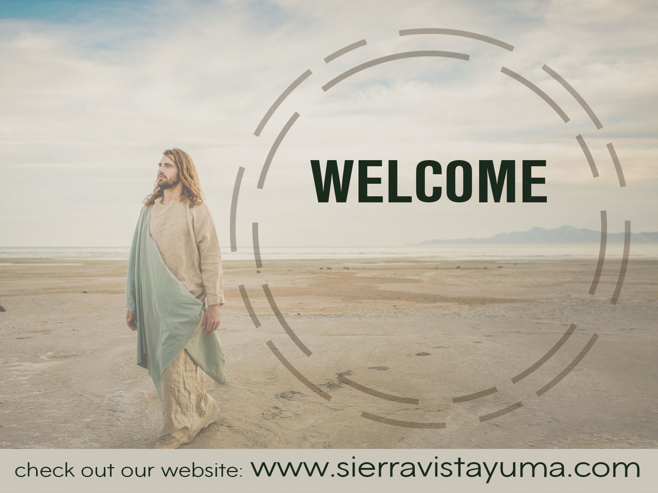
2ND SUNDAY
AFTER PENTECOST
JUNE 2ND, 2024

Slide 2
2ND SUNDAY
AFTER PENTECOST
JUNE 2ND, 2024

Slide 3
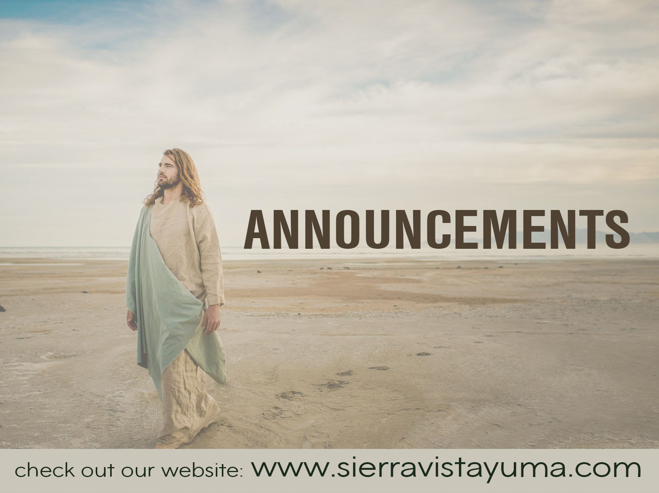

Slide 4


Slide 5


Slide 6


Slide 7
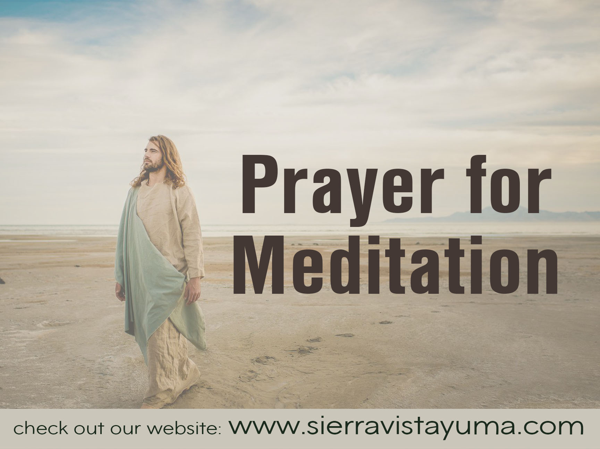

Slide 8
TRINITY
SUNDAY
May 26th, 2024

Slide 9
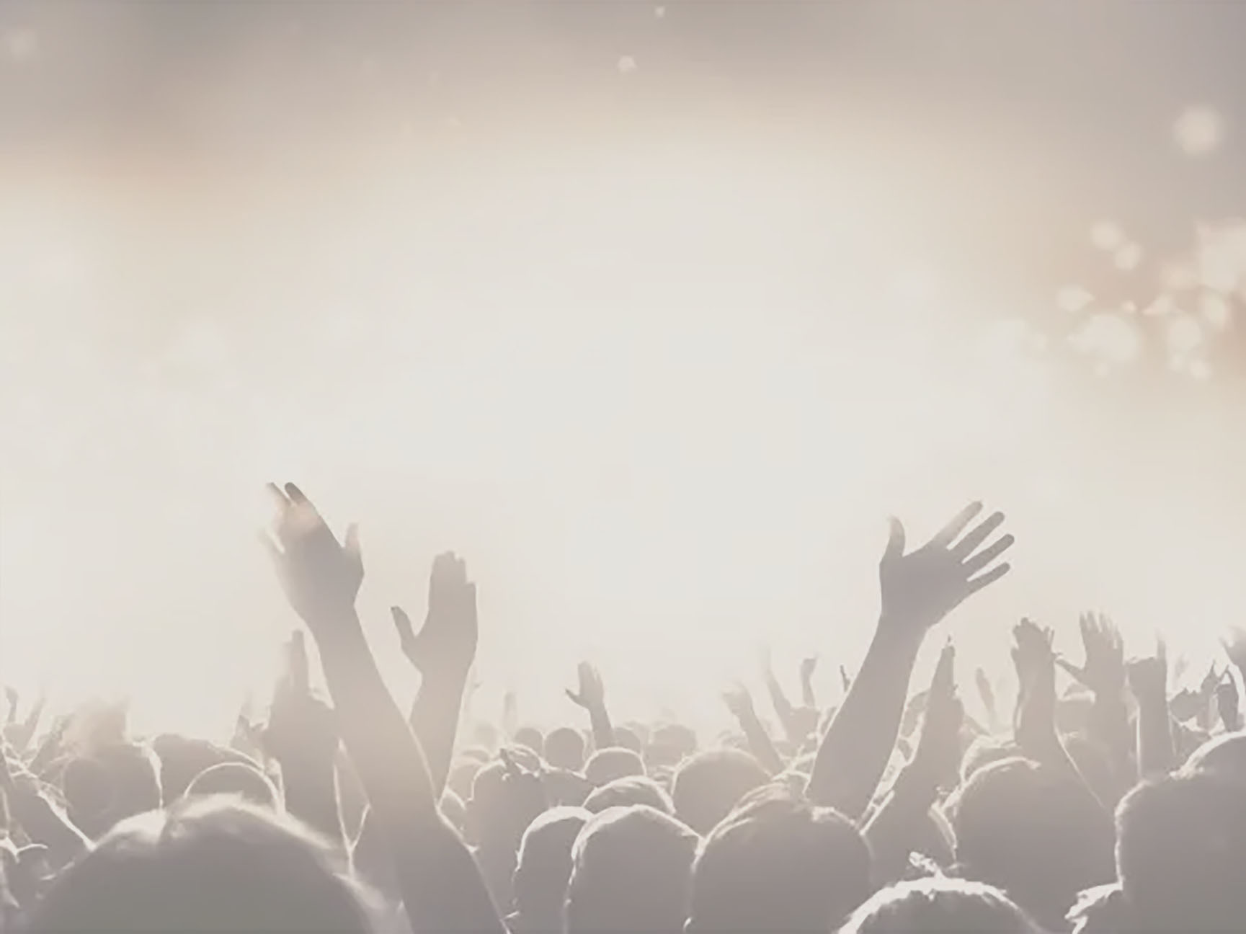
CROWN HIM WITH
MANY CROWNS #151

Slide 10
CROWN HIM WITH MANY CROWNS #151
Crown Him with many crowns,
The Lamb upon His throne;
Hark, how the heavenly
Anthem drowns
All music but its own!

Slide 11
CROWN HIM WITH MANY CROWNS #151
Awake, my soul, and sing
Of Him who died for thee,
And hail Him as thy
Matchless King
Through all eternity.

Slide 12
CROWN HIM WITH MANY CROWNS #151
Crown Him the Lord of love;
Behold His hands and side,
Rich wounds, yet visible above,
In beauty glorified:

Slide 13
CROWN HIM WITH MANY CROWNS #151
No angel in the sky
Can fully bear that sight,
But downward bends
His burning eye
At mysteries so bright

Slide 14
CROWN HIM WITH MANY CROWNS #151
Crown Him the Lord of peace;
Whose power a scepter sways
From people to pole,
That wars may cease,

Slide 15
CROWN HIM WITH MANY CROWNS #151
Absorbed in prayer and praise:
His reign shall know no end;
And round His pierced feet
Fair flower of paradise extend
Their fragrance ever sweet.

Slide 16
CROWN HIM WITH MANY CROWNS #151
Crown Him the Lord of years,
The Potentate of time;
Creator of the rolling spheres,
Ineffably sublime.

Slide 17
CROWN HIM WITH MANY CROWNS #151
All hail, Redeemer, hail!
For Thou hast died for me;
Thy praise shall never, never fail
Throughout eternity.

Slide 18
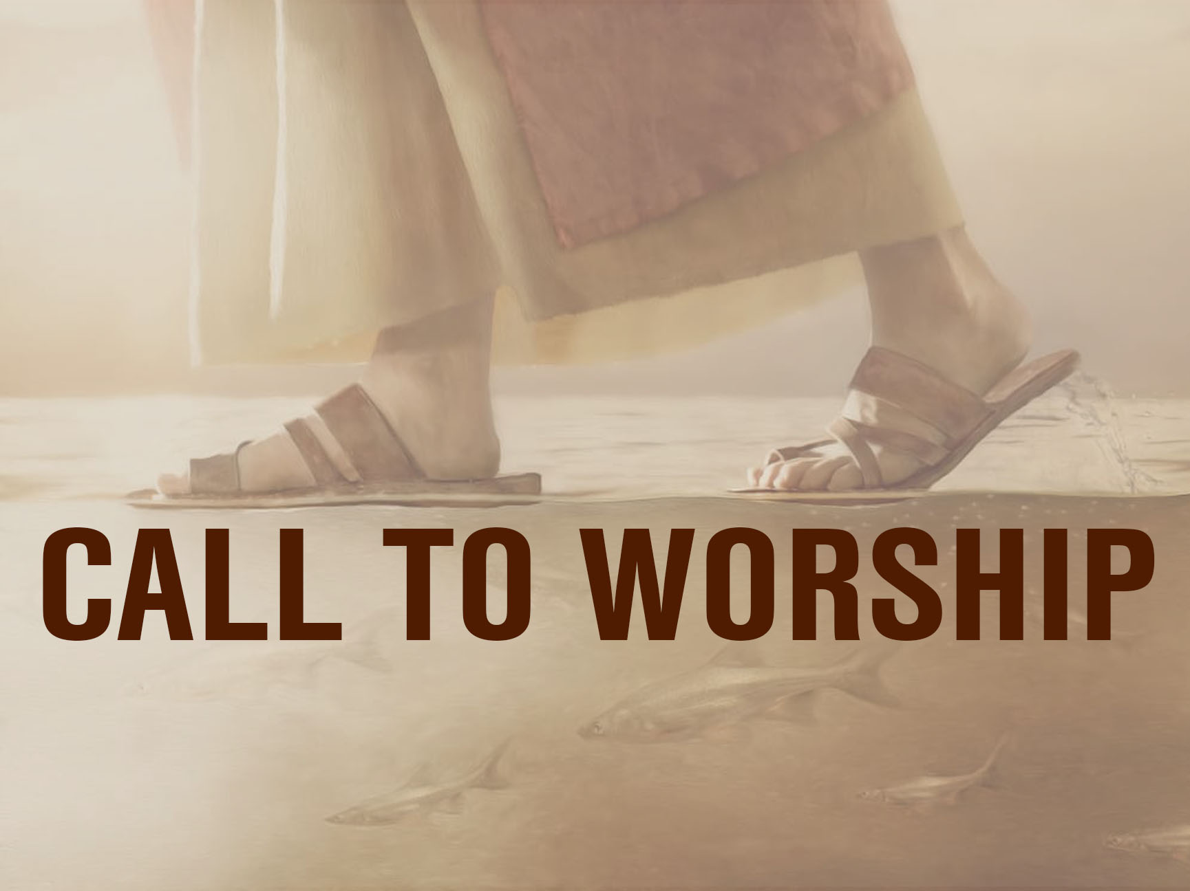

Slide 19
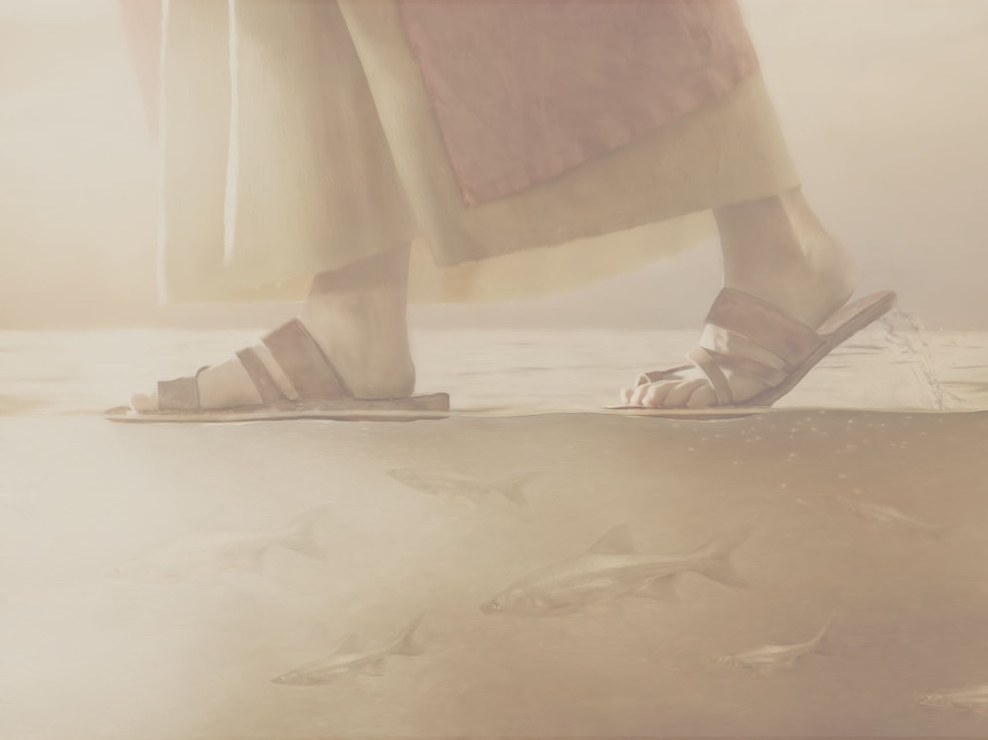
LEADER
The Lord is a refuge for the oppressed, a heaven in time of trouble.

Slide 20
ALL
Those who know your name, O God, put their trust in you.

Slide 21
LEADER
Have a pity on us, O Lord,
For you alone have power to lift us from the gate of death.

Slide 22
ALL
Sing praise to the Lord who is our help; proclaim to all peoples the great things God has done!

Slide 23
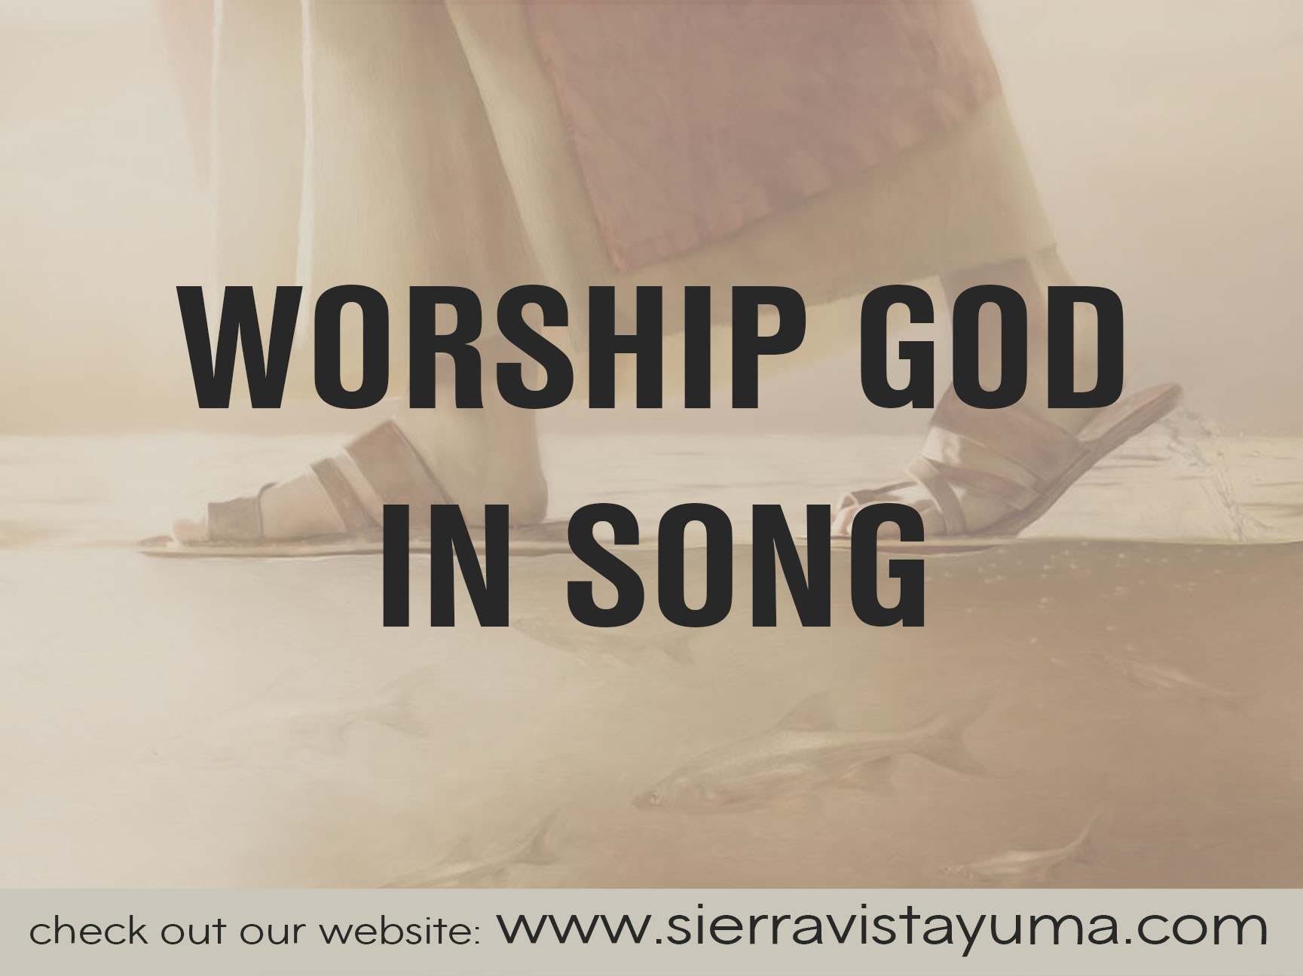

Slide 24
VICTORY IN JESUS

Slide 25
VICTORY IN JESUS
I heard and old, old story
How a Savior came from glory,
How He gave His life on Calvary
To save a wretch like me.

Slide 26
VICTORY IN JESUS
I heard about His groaning,
Of His precious blood’s atoning.
Then I repented of my sins
And won the victory.

Slide 27
VICTORY IN JESUS
O, victory in Jesus,
My Savior, forever.
He sought me and bought me
With His redeeming blood.

Slide 28
VICTORY IN JESUS
He loved me ere I knew Him
And all my love is due Him.
He plunged me to victory
Beneath the cleansing flood.

Slide 29
VICTORY IN JESUS
I heard about His healing,
Of His cleansing power revealing.
How He made the lame to walk again
And caused the blind to see.

Slide 30
VICTORY IN JESUS
And then I cried, “Dear Jesus,
Come and heal my broken spirit”
And somehow Jesus came
And brought to me the victory.

Slide 31
VICTORY IN JESUS
O, victory in Jesus,
My Savior, forever.
He sought me and bought me
With His redeeming blood.

Slide 32
VICTORY IN JESUS
He loved me ere I knew Him
And all my love is due Him.
He plunged me to victory
Beneath the cleansing flood.

Slide 33
VICTORY IN JESUS
I heard about a mansion
He has built for me in glory,
And I heard about the
streets of gold
Beyond crystal sea

Slide 34
VICTORY IN JESUS
About the angels singing
And the old redemption story,
And some sweet day I’ll sing up there the song of victory.

Slide 35
VICTORY IN JESUS
O, victory in Jesus,
My Savior, forever.
He sought me and bought me
With His redeeming blood.

Slide 36
VICTORY IN JESUS
He loved me ere I knew Him
And all my love is due Him.
He plunged me to victory
Beneath the cleansing flood.

Slide 37
NEW CREATION

Slide 38
NEW CREATION
I thought I knew
what I was talking about
When I testified of
Your great love

Slide 39
NEW CREATION
Well I was a soul on fire,
There was no doubt
Bible believing, saved,
And washed in the blood.

Slide 40
NEW CREATION
But it wasn’t ‘til I stumbled
And made my mistakes
That I could know in my soul
How amazing was grace

Slide 41
NEW CREATION
You brought me blessings
Out of tragedy
You turned my old song
Into a symphony

Slide 42
NEW CREATION
And with Your spirit
Living inside of me
I’m a new creation
I’m a new creation

Slide 43
NEW CREATION
And now I know what
You were talking about
Went from my head
Into my heart

Slide 44
NEW CREATION
When I was broken
At the bottom, I found
You are my Healer and Redeemer
Jesus, that’s who You are

Slide 45
NEW CREATION
You brought me blessings
Out of tragedy
You turned my old song
Into a symphony

Slide 46
NEW CREATION
And with Your spirit
Living inside of me
I’m a new creation
I’m a new creation

Slide 47
NEW CREATION
Oh, oh-oh, oh, oh
Oh, oh-oh, oh, oh

Slide 48
NEW CREATION
But it wasn’t ‘til I stumbled
And made my mistakes
That I could know in my soul
How amazing was grace

Slide 49
NEW CREATION
You brought me blessings
Out of a tragedy
You turned my old song
Into a symphony

Slide 50
NEW CREATION
And with Your spirit
Living inside of me
I’m a new creation

Slide 51
NEW CREATION
(Oh, oh-oh, oh,oh)
You brought me blessings
Out of a tragedy
You turned my old song
Into a symphony

Slide 52
NEW CREATION
And with Your spirit
Living inside of me
I’m a new creation
I’m a new creation

Slide 53
NEW CREATION
Oh, oh-oh, oh, oh
Oh, oh-oh, oh, oh

Slide 54
NEW CREATION
And with Your spirit
Living inside of me
I’m a new creation
I’m a new creation

Slide 55
HUNGRY

Slide 56
HUNGRY
Hungry, I come to You
For I know You satisfy
I am empty, but I know Your love
Does not run dry.

Slide 57
HUNGRY
And so I wait for You,
So I wait for You.

Slide 58
HUNGRY
I am falling on my knees
Offering all of me
Jesus, You’re all
This heart is living for.

Slide 59
HUNGRY
Broken, I run to You
For Your arms are open wide.
I am weary, but I know Your touch
Restores my life

Slide 60
HUNGRY
And so I wait for You,
So I wait for You.

Slide 61
HUNGRY
I am falling on my knees
Offering all of me
Jesus, You’re all
This heart is living for.

Slide 62
HUNGRY
I am falling on my knees
Offering all of me
Jesus, You’re all
This heart is living for.

Slide 63
HUNGRY
Hungry, I come to You
For I know You satisfy
I am empty, but I know Your love
Does not run dry.

Slide 64
HUNGRY
And so I wait for You,
So I wait for You.

Slide 65
HUNGRY
I am falling on my knees
Offering all of me
Jesus, You’re all
This heart is living for.

Slide 66
HUNGRY
I am falling on my knees
Offering all of me
Jesus, You’re all
This heart is living for.

Slide 67


Slide 68
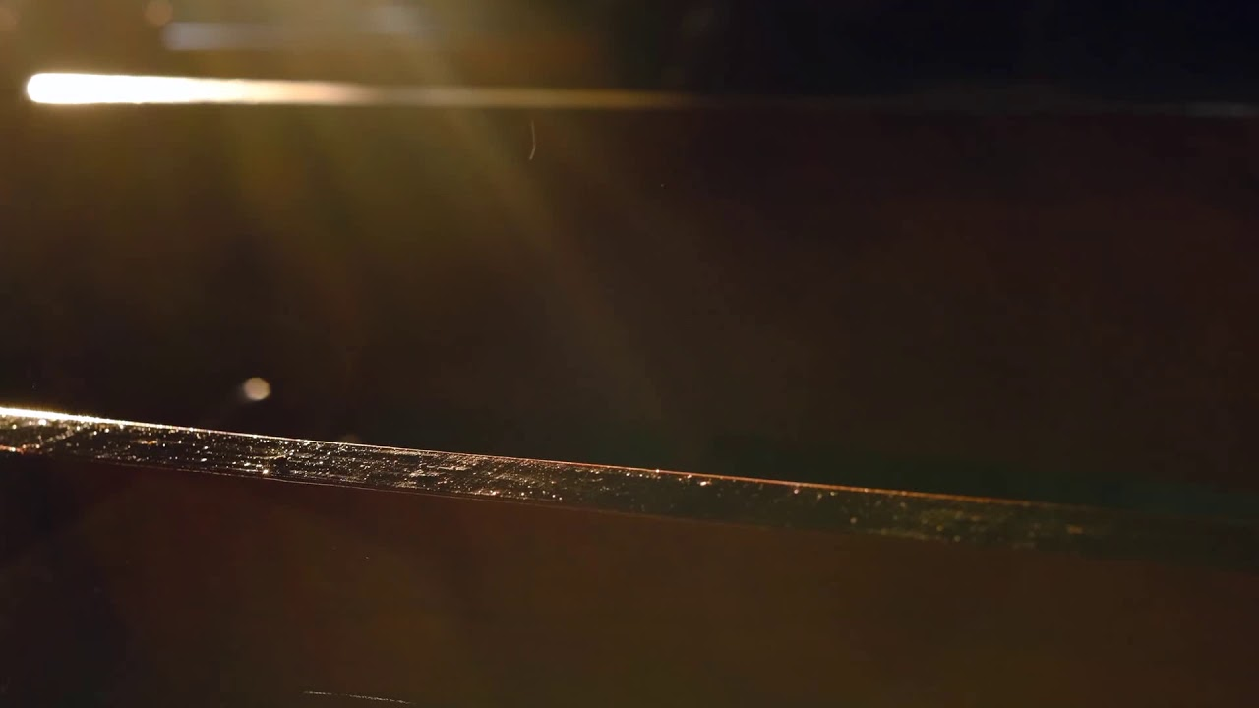
MATTHEW 13:18-23
“ADJUST YOUR FOCUS”
(NIV)
BRIAN CLAAR

Slide 69

“Listen then to what the parable of the sower means: When anyone hears the message about the kingdom and does not understand it, the evil one comes and snatches away what was sown in their heart
MATTHEW 13:18-23 (NIV)

Slide 70
This is the seed sown along the path. The seed falling on rocky ground refers to someone who hears the word and at once receives it with joy. But since they have no root, they last only a short time
MATTHEW 13:18-23 (NIV)

Slide 71
When trouble or persecution comes because of the word, they quickly fall away. The seed falling among the thorns refers to someone who hears the word, but the worries of this life and the deceitfulness of
MATTHEW 13:18-23 (NIV)

Slide 72
wealth choke the word, making it unfruitful. But the seed falling on good soil refers to someone who hears the word and understands it. This is the one who produces a crop, yielding a hundred, sixty or thirty times what was sown.”
MATTHEW 13:18-23 (NIV)

Slide 73
PASTOR:
THIS IS THE WORD
OF THE LORD
ALL:
THANKS BE TO GOD

Slide 74
MATTHEW 13:18-23
“ADJUST YOUR FOCUS”
(NIV)
BRIAN CLAAR

Slide 75

PLEASE GIVE ONLINE AT
www.sierravistayuma.com
OR MAIL YOUR TITHES AND
OFFERINGS TO THE CHURCH.
150 W. 28th St.
Yuma, AZ 85364

Slide 76
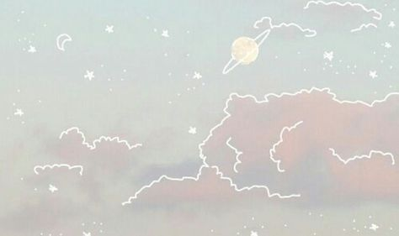
DOXOLOGY
Praise God,
From whom all blessings flow;
Praise Him, all creatures here below
Praise Him, above, ye heavenly host.
Praise Father, Son and Holy Ghost.
Amen

Slide 77
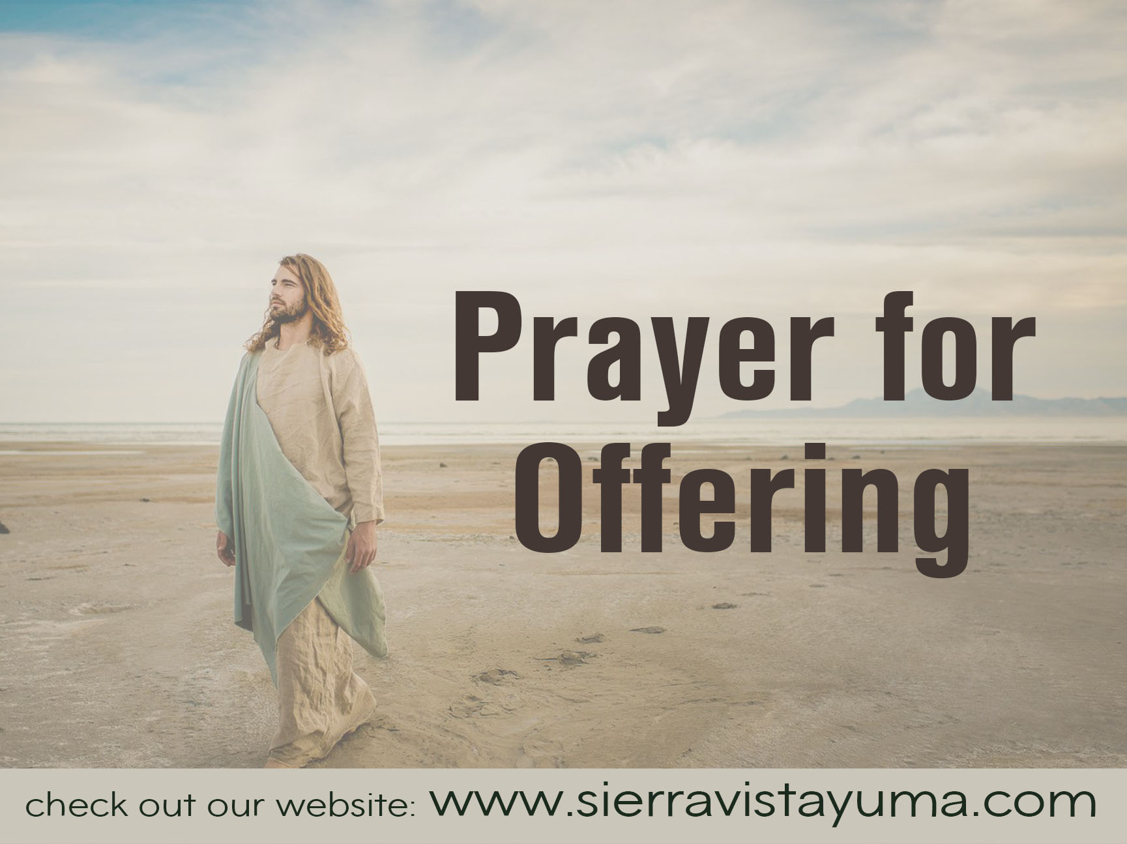

Slide 78
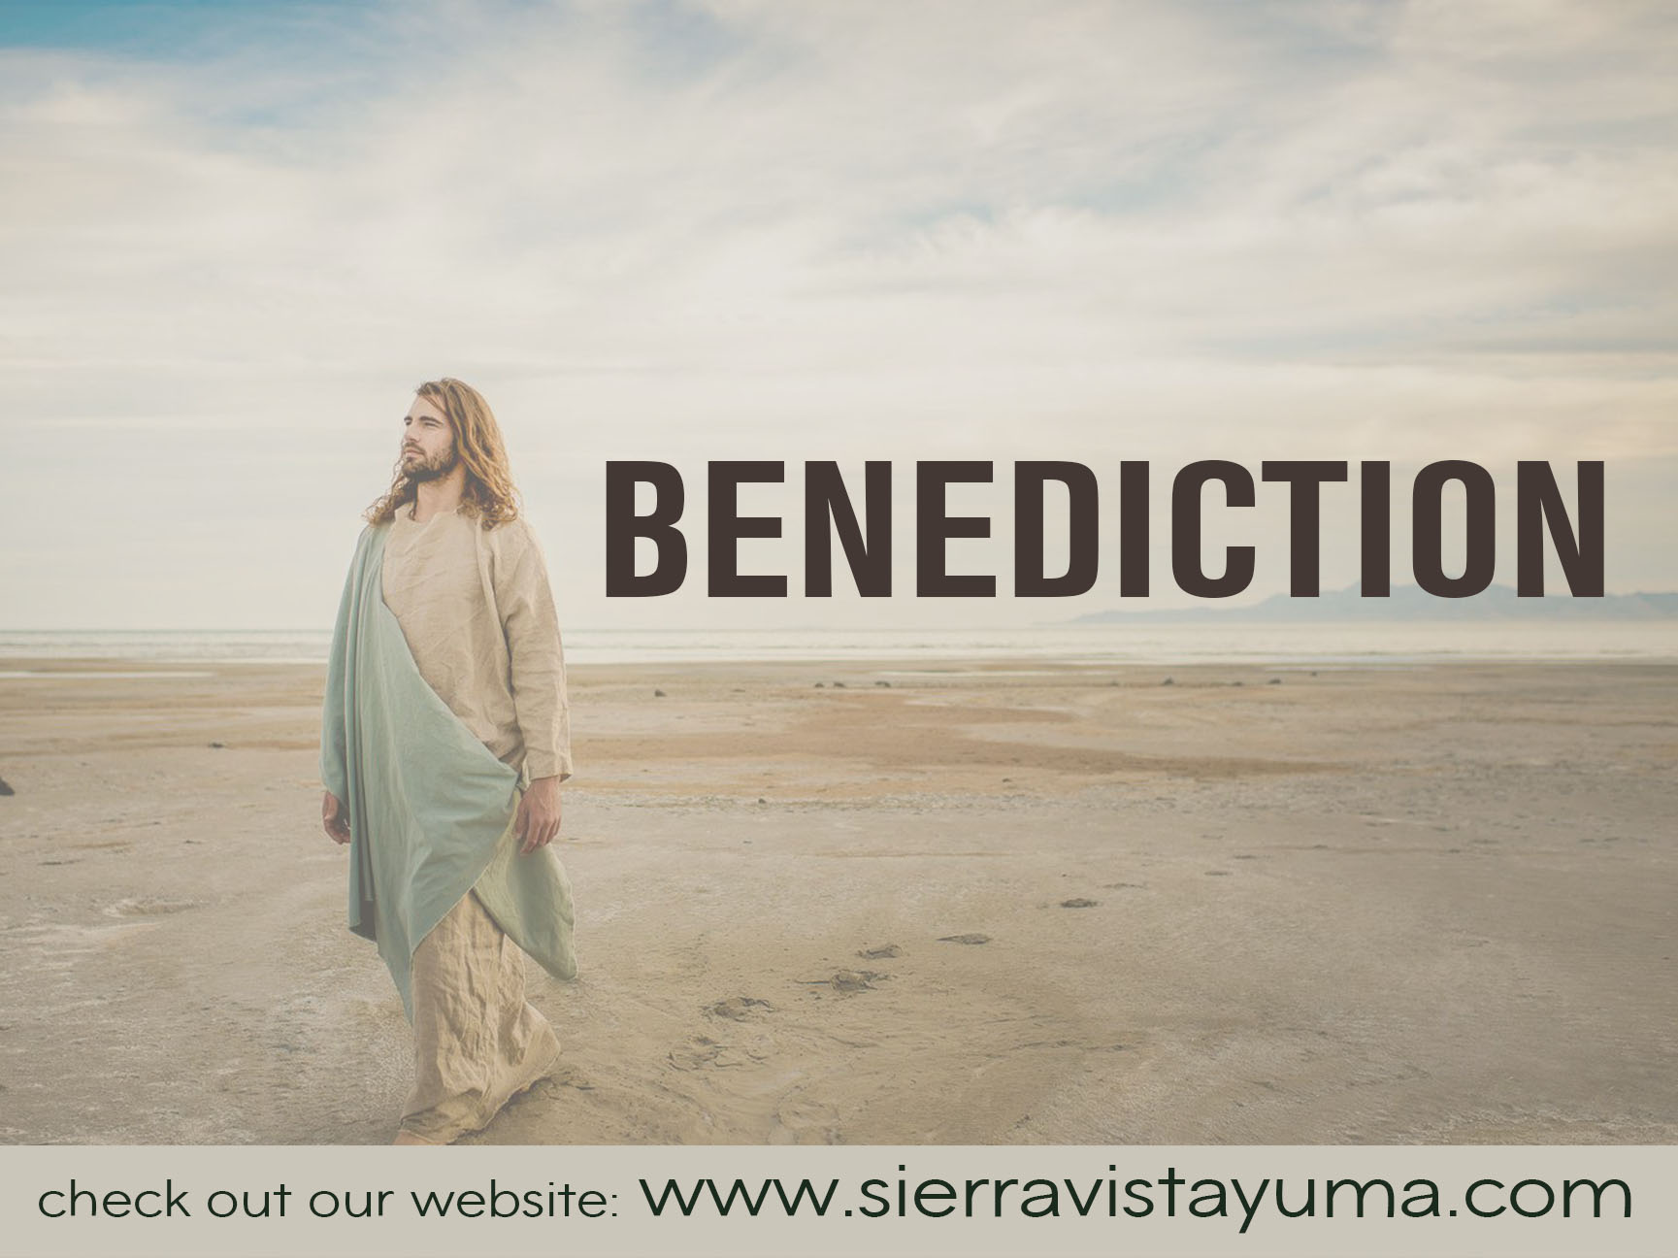

Slide 79
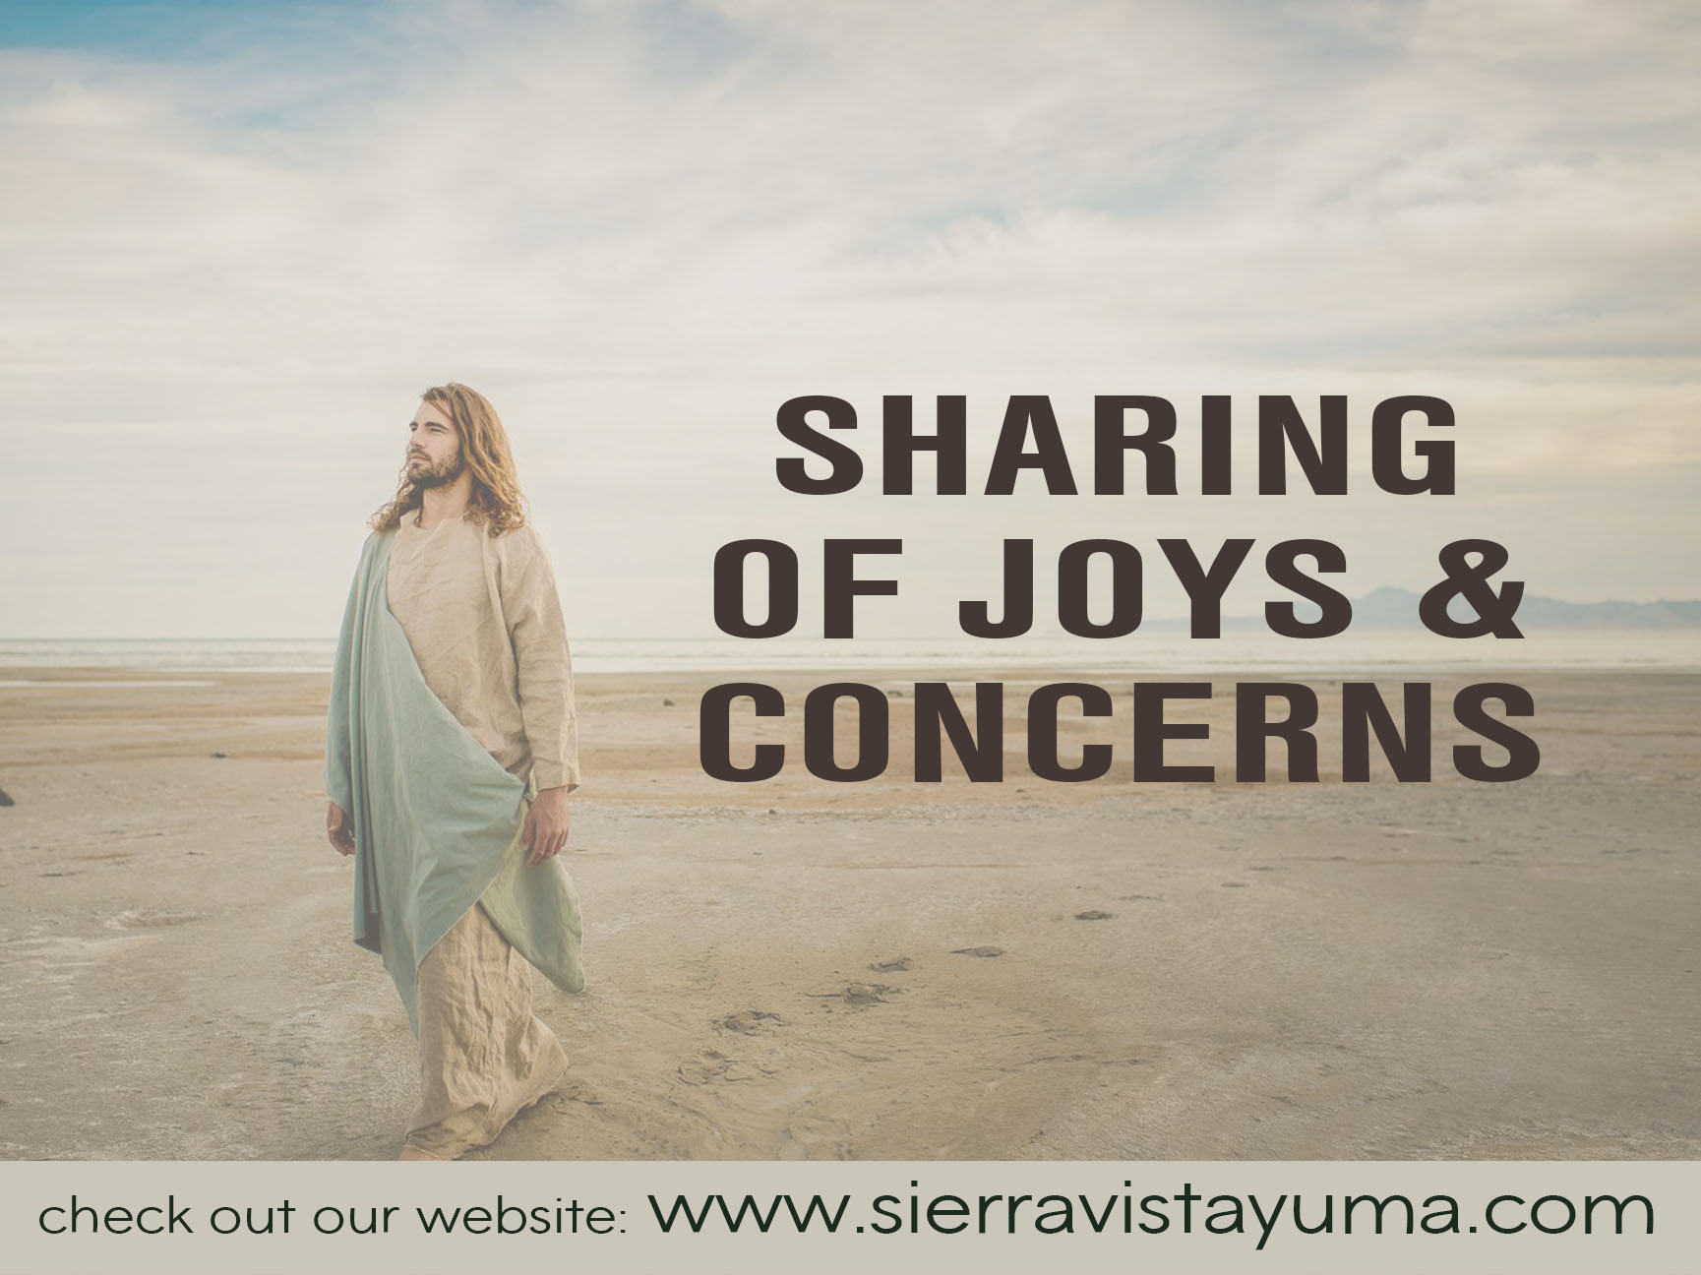

Slide 80
BE THOU MY
VISION #339

Slide 81
BE THOU MY VISION #339
Be Thou my vision,
O Lord of my heart;
Nought be all else to me,
Save thet Thou art

Slide 82
BE THOU MY VISION #339
Thou my best though,
By day or by night,
Waking or sleeping,
Thy presence my light.

Slide 83
BE THOU MY VISION #339
Riches I heed not, nor vain,
Empty praise,
Thou mine inheritance,
Now and always:

Slide 84
BE THOU MY VISION #339
Thou and Thou only,
First in my heart,
Great God of heaven,
My treasure Thou art.

Slide 85
BE THOU MY VISION #339
Be Thou my wisdom,
And thou my true word;
I ever with thee and
Thou with me, Lord;

Slide 86
BE THOU MY VISION #339
Heart of my own heart,
Whatever befall,
Still be my vision,
O Ruler of all

Slide 88
GO WITH US
LORD #535

Slide 89
GO WITH US LORD #535
Go with us, Lord,
And guide the way
Through this and
every coming day,

Slide 90
GO WITH US LORD #535
That in Your Spirit
Strong and true
Our lives may be
Our gift to You.

Slide 91


